Slide 1
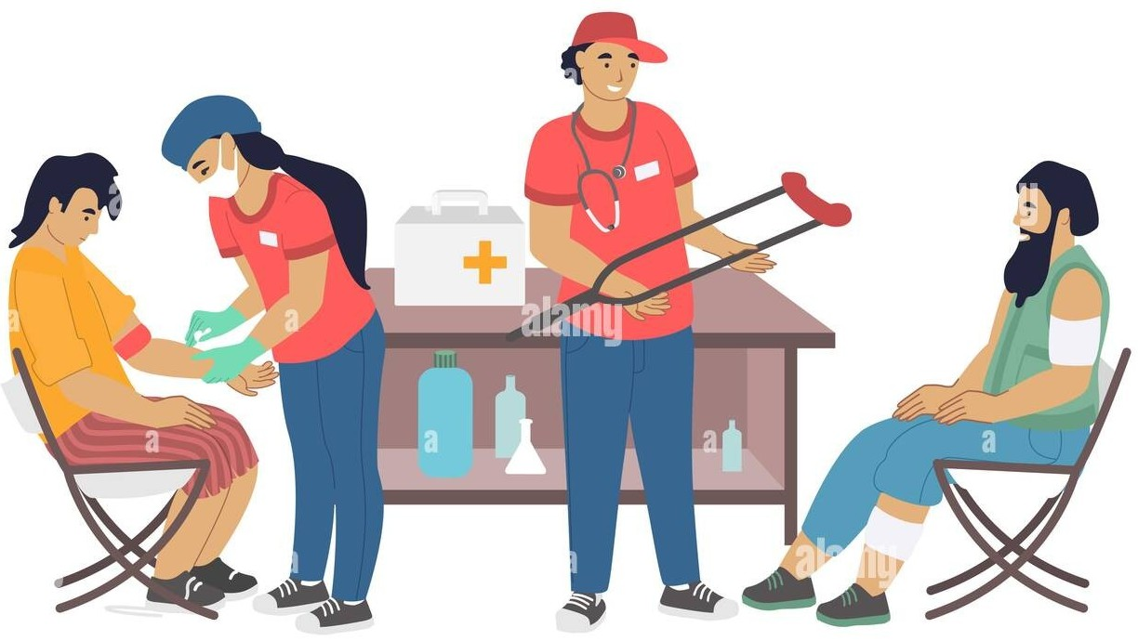

Homeless Health Connect Accessible care for Vulnerable lives 12.09.2024
Group – 51
Sahithi Dachepally
Vimala Suram
Ashish Babish Gangaramani

Slide 2
Overview
Introduction
Proposed Solution
Application
Stakeholders and their Contribution
Key Feaures

Slide 3
Problem Statement
Over half a million Americans experience homelessness on any given night, representing 0.2% of the U.S. population.
The connection between housing and homelessness is well-recognized, but the relationship between health and homelessness is often underestimated.
Living on the streets or in overcrowded shelters causes significant stress and exposes individuals to higher health risks.
Homeless individuals are more susceptible to communicable diseases such as tuberculosis (TB), respiratory illnesses, the flu, and vitamin deficiencies.
Homelessness also increases the risk of violence, malnutrition, and exposure to harsh weather conditions.
Health Demographics
Health Condition | Prevalence Among Homeless Individuals | Prevalence in General Population | Increased Risk
Tuberculosis | 3.2% | 0.8% | 0.2*
Pneumonia | 3.4% | 1.5% | 0.1*
High blood pressure | 51.5% | 49.4% | 0.4*
Diabetes | 26.2% | 22.4% | 0.1*
Source: Health Conditions Among Individuals with a History of Homelessness Research Brief | ASPE

Slide 4
Overview
Introduction
Proposed Solution
Application
Stakeholders and their Contribution
Key Feaures

Slide 5
Proposed Solution
Objective
NGOs connects homeless individuals with healthcare facilities, enabling them to access affordable medical treatment and reducing health risks.
Registration
Volunteers register homeless individuals and input their medical history. After registration, a hospital is assigned to them based on their location.
Department Allocation
The appropriate medical department is determined based on the individual's symptoms and medical history.
Blood Test
Symptom-based tests are conducted, and if serious issues are found, appropriate actions are taken. If results are normal, further analysis is done.
Diagnosis and Health Report
A diagnosis is made, and a detailed health report is generated and shared with the assigned hospital for treatment.
Outcome
This solution ensures homeless individuals receive timely and affordable healthcare, minimizes health risks, and supports better overall health outcomes.

Slide 6
Overview
Introduction
Proposed Solution
Application
Stakeholders and their Contribution
Key Feaures

Slide 7
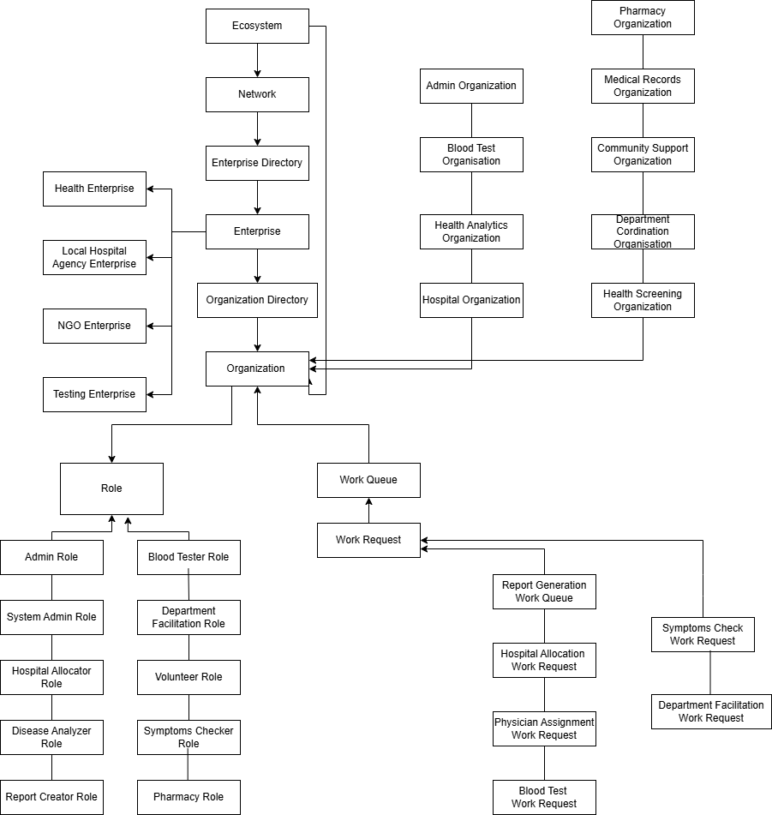
Object Model

Slide 8
Overview
Introduction
Proposed Solution
Application
Stakeholders and their Contribution
Key Feaures

Slide 9
Stakeholders & their Contribution
Volunteers
Register homeless individuals, input medical history, and help connect them to appropriate healthcare facilities, ensuring smooth onboarding and coordination
Medical Staff
Includes, pathologists, doctors, assistant doctors to conduct tests, analyze results, diagnose conditions, and provide treatment based on health reports, ensuring timely and appropriate care.
Hospitals
Offer medical services and treatment to individuals based on the information provided by the system, contributing to better health outcomes.
Report Generator
Oversees the entire process, from data collection to analysis, and creates detailed health reports. It also sends these reports via email to the patient, ensuring they are informed about their medical status.
Users (Homeless Individuals)
Receive healthcare services and reports, participate in health assessments, and follow up on recommended treatments to improve their health.
Admin
Responsible for creating, deleting, and updating user accounts to maintain accurate and up-to-date records. They ensure proper user management and maintain system security and data integrity.

Slide 10
Overview
Introduction
Proposed Solution
Application
Stakeholders and their Contribution
Key Feaures

Slide 11
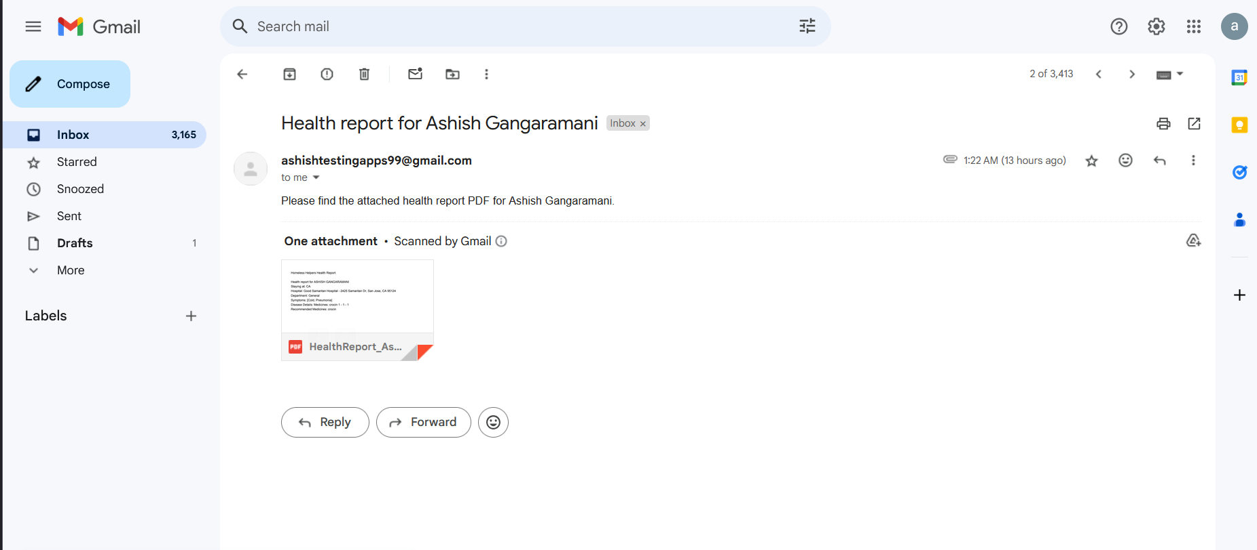
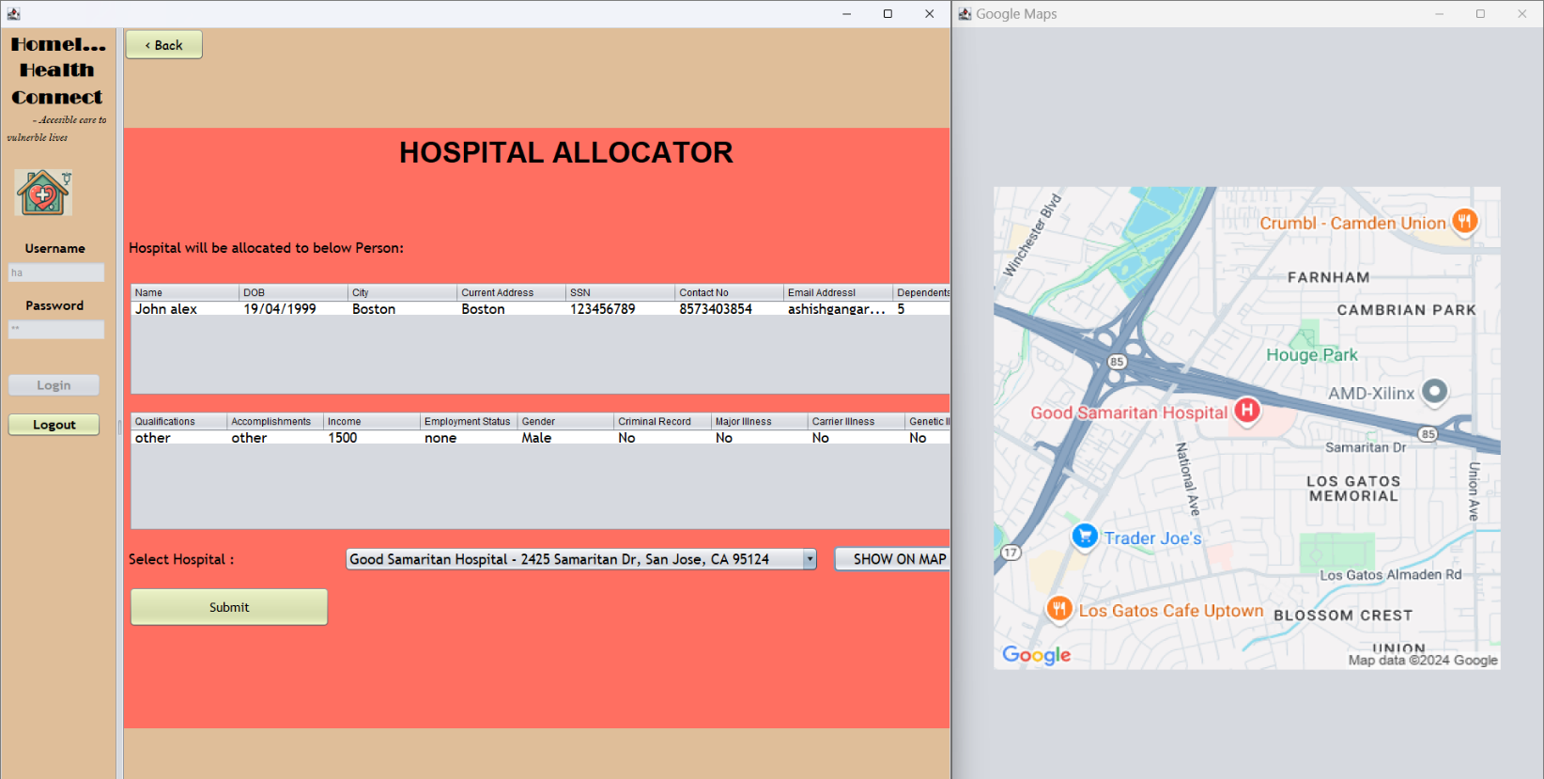
Key Features
A map is provided to display the locations of hospitals, allowing homeless individuals and volunteers to easily identify and navigate to the assigned healthcare facilities.
The system creates detailed health reports that include diagnosis, test results, and treatment recommendations. These reports are then shared with the assigned hospital to ensure informed and effective medical care.
Emails are sent to users containing their detailed health reports and any essential information regarding their treatment.

Slide 12
THANK YOU

